Slide 1
NORTH SOUTH UNIVERSITY
Summer Semester 2023

Slide 2
Prophet Muhammad (peace be upon him) used to say, 'The best among you are the best in character (having good manners)'.
Sahih Al-Bukhari, The Book of Al-Adab (Good Manners), Volume:8

Slide 3
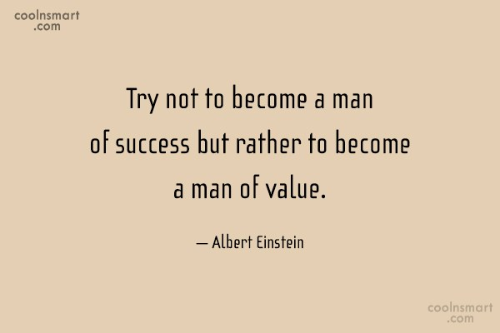

Slide 4
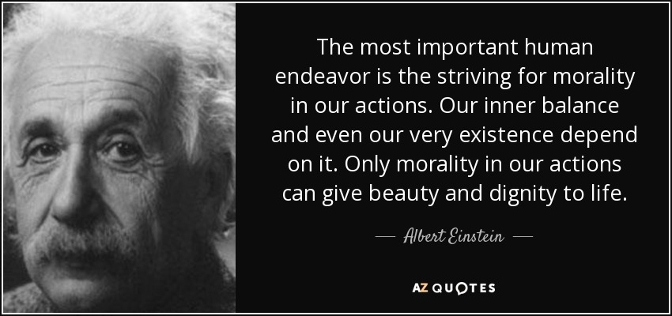

Slide 5
Is he your friend?

Slide 6
Are you a graduate student?

Slide 7
Do you play cricket?

Slide 8
Did John make a false statement on his income tax return?

Slide 10
Edward Joseph Snowden (born June 21, 1983) is an American computer professional, former Central Intelligence Agency (CIA) employee, and former contractor for the United States government, who copied and leaked classified information from the National Security Agency (NSA) in 2013 without prior authorization. His disclosures revealed numerous global surveillanceprograms, many run by the NSA and the Five Eyes Intelligence Alliance, with the cooperation of telecommunication companies and European governments.

Slide 11
The documents Snowden revealed provided a vital public window into the NSA and its international intelligence partners’ secret mass surveillance programs and capabilities. These revelations generated unprecedented attention around the world on privacy intrusions and digital security, leading to a global debate on the issue.

Slide 12
“I don't want to live in a world where everything I say, everything I do, everyone I talk to, every expression of creativity and love or friendship is recorded.”

Slide 13
Snowden
Certainly impossible to separate from the PRISM program, but in addition to the privacy issues raised, Snowden’s actions also forced a reconsideration of what an organizational whistleblower is, and what role conscience plays in such matters.

Slide 14
Case 1
In 1986 the space shuttle Challenger exploded causing the death of seven astronauts. A subsequent investigation of the culture at NASA revealed important lessons. There was not one single error that occurred, and neither did the managers intentionally commit wrongdoing. Yet it could have been prevented. The errors were years in the making.

Slide 15
NASA engineers noticed damage to crucial O-rings yet they repeatedly convinced themselves the damage was acceptable. One analyst described it as “an incremental descent into poor judgment.” (What prevents us from seeing that which is in front of our eyes?)
Should the engineers be responsible for the death of astronauts?

Slide 16
Case 2
You are a doctor at a top hospital. You have six gravely ill patients, five of whom are in urgent need of organ transplants. You can’t help them, though, because there are no available organs that can be used to save their lives. The sixth patient, however, will die without a particular medicine. If s/he dies, you will be able to save the other five patients by using the organs of patient 6, who is an organ donor. What do you do?

Slide 17


Slide 18
How should we live?

Slide 19
Should we tell lie to save a life?

Slide 20
Should we permit embryonic stem cell research?

Slide 21
Should we clone animals?

Slide 22
Should we clone human?

Slide 24
ETHICS

Slide 25
PHI 104
Introduction to Ethics

Slide 26
Faculty
PROF. DR. Md. MUNIR HOSSAIN TALUKDER
[MnT]

Slide 27
PROF. DR. MUNIR Hossain TALUKDER
Adjunct Faculty
Department of History and Philosophy
North South University
&
Professor
Department of Philosophy
Jahangirnagar University, Savar, Dhaka

Slide 28
Contact No. 01712722244
Mobile: 01712722244
E-mail:
munir.talukder@northsouth.edu
Office Room: NAC 1155

Slide 29
Some Important Notes

Slide 30
Some Important Notes
Firstly, Attendance is very important. Prepare yourself before the class.
Students should attend all lectures during the semester, as no make-up / re-take examination / assignment will be allowed. Absence in three consecutive classes may result drop from a course.
So, Please Come in time and don’t be late!

Slide 31
Some Important Notes
Secondly, Any missed examination/ assignment will be considered as a zero credit point. A student who knows of necessary class absences should consult the instructor in advance.
So, Please don’t miss any Exam!

Slide 32
Marks Distribution, Examinations and Assignments:
Midterm Exam 20
Viva-voce 10
Class Test (3 Quizzes) 20
Project Report/Assignment 10
Attendance & Class Participation 10
Final Exam 30
________________________________
Total 100
* Serious and hard-working students are encouraged for an individual class presentation.

Slide 33
Absence
If any student is absent in three consecutive classes he/she will have to submit an assignmentwithapplication. Topic will be given by the faculty.

Slide 34
Some Important Notes
Thirdly, Any academic dishonesty such as, plagiarism, copying from another student's paper, cheating in examination may cause an F grade in the course.
So, Please have self-respect and be confident on your own power!

Slide 35
Grading
Grading:
Numerical Scores | Letter Grade | Grade Points
93 and above | A | 4.0
90-92 | A− | 3.7
87-89 | B+ | 3.3
83-86 | B | 3.0
80-82 | B− | 2.7
77-79 | C+ | 2.3
73-76 | C | 2.0
70-72 | C− | 1.7
67-69 | D+ | 1.3
60-66 | D | 1.0
Below 60 | F* Failure | 0.0

Slide 36
Some Important Notes
Students are advised to read university policies carefully regarding examinations and academic honesty.
Know your university NSU!

Slide 37
Basic Books
Basic Books:
Fiala, Andrew & Mackinnon, Barbar (2014), Ethics: Theory and Contemporary Issues, London: Cengage Learning.
May, Larry et al. (2011), Applied Ethics: A Multicultural Approach, Boston: Prentice-Hall.
Tannsjo, Torbjorn (2009), Understanding Ethics: An Introduction to Moral Theory, London: Edinburgh University Press.

Slide 38
Reference Books
Aristotle: Nicomachean Ethics (Book II), Trans. by W.D. Ross, Publisher: Batoche Books
Utilitarianism (Chapter 2), by John Stuart Mill, Publisher: Seven Treasures Publications, ISBN 9781439297629
An Introduction to the Principles of Morals and Legislation (Chapter IV), by Jeremy Bentham, Publisher: Dover Publications, ISBN 0-486-4545-5

Slide 39
Reference Books
Swazo, N.K. ed. Topics in Moral Philosophy and Applied Ethics: An Anthology (Dhaka: Century Publications, 2018)
Swazo, N.K. "A Request for Non-voluntary Euthanasia in Bangladesh: A Moral Assessment," Bioethics in Faith and Practice, Vol. 3, No. 1, Article 6, 2017, pp. 23-35
Talukder, M.M.H, Nature and Life: Essays on Deep Ecology and Applied Ethics (Newcastle: Cambridge Scholars Publishing, 2018)

Slide 40
Contact me
Feel Free to talk with me regarding any issue of this course at my office. Call me any time or drop me an email at your convenience.
Wish you all the best for your academic journey

Slide 41
Welcome to my lectures

Slide 42
What we are going to learn?
Course Description (Catalog Description):
The current course reveals ethical behavior for distinguishing between good and evil or right and wrong. It presents the combined influence of satyam, shivam and sundaram, or truth, good and beautiful, as reflected in the concept of ethical excellence in almost every generation of human society. It shows how developing and maintaining high moral values and ethical conduct is crucial in combating corruption and social crimes in public life today. This course familiarizes students with the critical works on the subject within public governance and management practices in recent decades across the globe. It introduces students to virtue ethics, utilitarianism in the Western philosophical tradition, examines the moral debate between universalism and relativism, and demonstrates various analysis methods applied to contemporary ethical problems. Issues related to abortion, reproductive technologies, organ transplantation, affirmative action, capital punishment, euthanasia, conflict and violence, gender discrimination, violation of human rights, environmental degradation, etc., are examined here. Finally, the course will review a liberal, pragmatic and multicultural perspective on ethical theory and moral problems.

Slide 43
LECTURE 1
Introduction to Ethics
20/07/2023

Slide 44
Definition of Ethics
“Ethics is a branch of philosophy; it is moral philosophy or philosophical thinking about morality, moral problems and moral judgments.”

Slide 45
Another Definition of Ethics
“We may define ethics as the normative science of the conduct of human beings living in societies-a science which judges this conduct to be right or wrong, to be good or bad, or in some similar way.”

Slide 46
Ethicists
An ethicist has enough knowledge about ethical principles, ethical theories, ethical terms and their applications.

Slide 47
Ethical Expertise
An ethical expert suggests how one can solve ethical dilemma or act ethically in a particular situation. He or she is like a consultant, lawyer or a software expert.

Slide 48
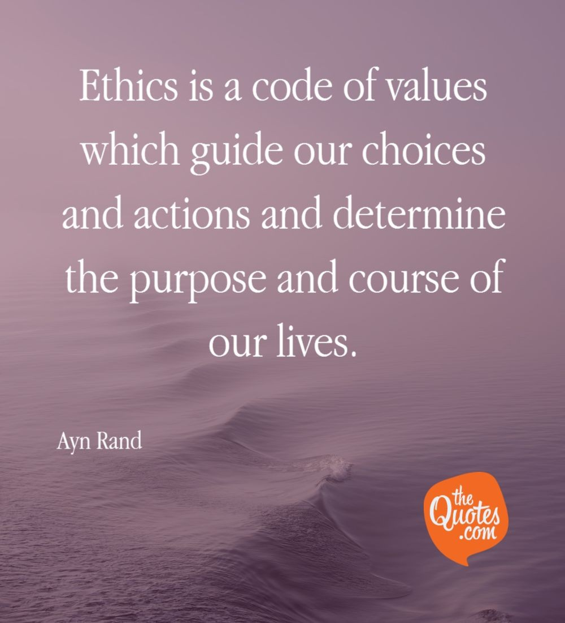

Slide 49
Some thought experiments
What is ethics? Write 5 ethical issues regarding your own department.
Do we need ethics? Why? Or Why not?
THANK YOU!!!

